Slide 1
Labeling the notable object and the hazard level of traffic scene

Slide 2
Introduction
In this job, we will give you a image from traffic scene, and ask you two questions.
Remind that, you have no information like speed, local traffic rules. You can only judge by the image you see.
There are two questions we hope you can fulfill.
About the whole image: How dangerous is this scene for the driver?
There are four levels to choose: no danger, low level, middle level, and high level.
About a segment of this image: If you are a co-driver, how will you warn the driver about this segment?
There are four levels to choose: irrelevance, attention, alert, and highly alert.

Slide 3
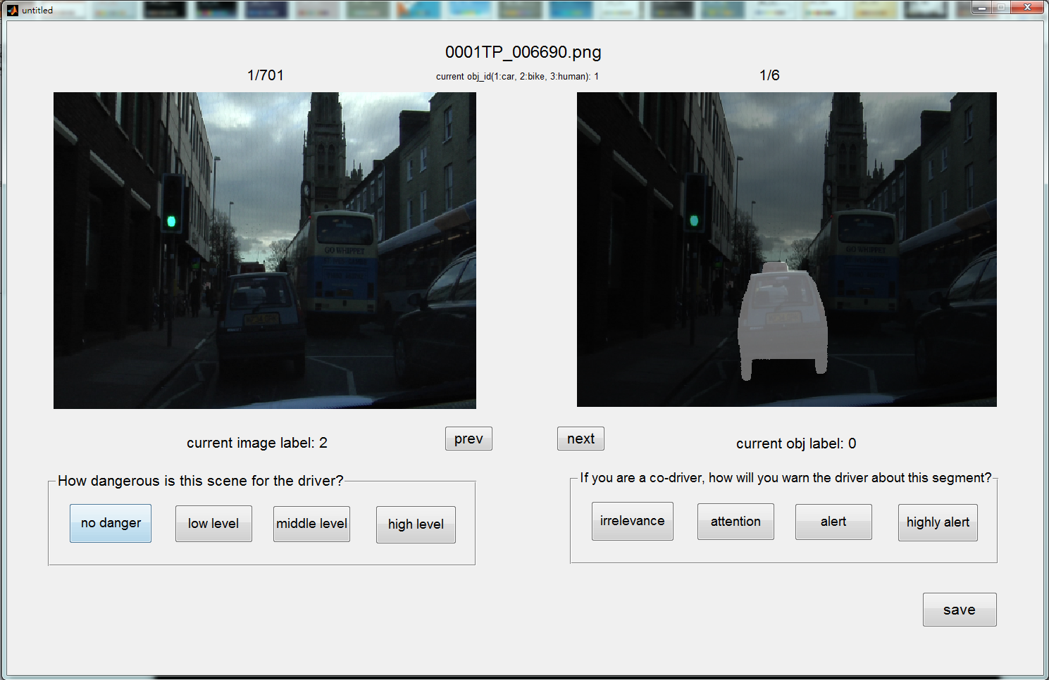
User Interface
#current image/#total image
#current segment/#total segment
The class of
current segment

Slide 4
User Interface
Question 1: current image
Question 2: one of segments of current image

Slide 5
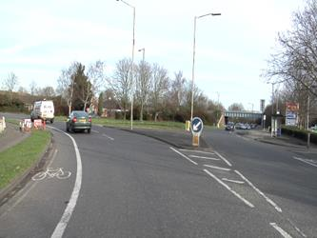
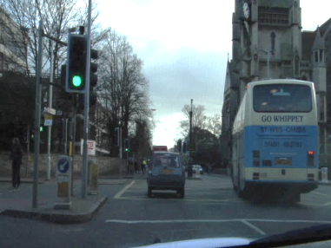
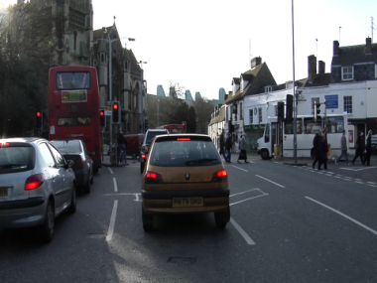
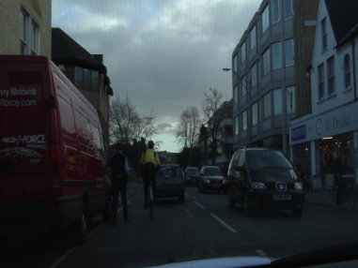
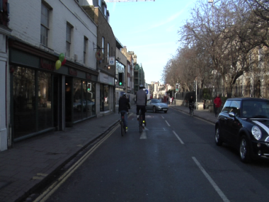
About The Question 1
You can first take a look at following images. That may help you to judge the hazard level of the labeling image.

Slide 6
About The Question 2
Suggest that you can write down your judge rules about question 2.

Slide 7
Labeling Steps
Step1: please answering the question 1(left side)

Slide 8
Step 2: answer the question 2(right side)

Slide 9
Step 3: Then press the next button to the next segment, and label it.

Slide 10
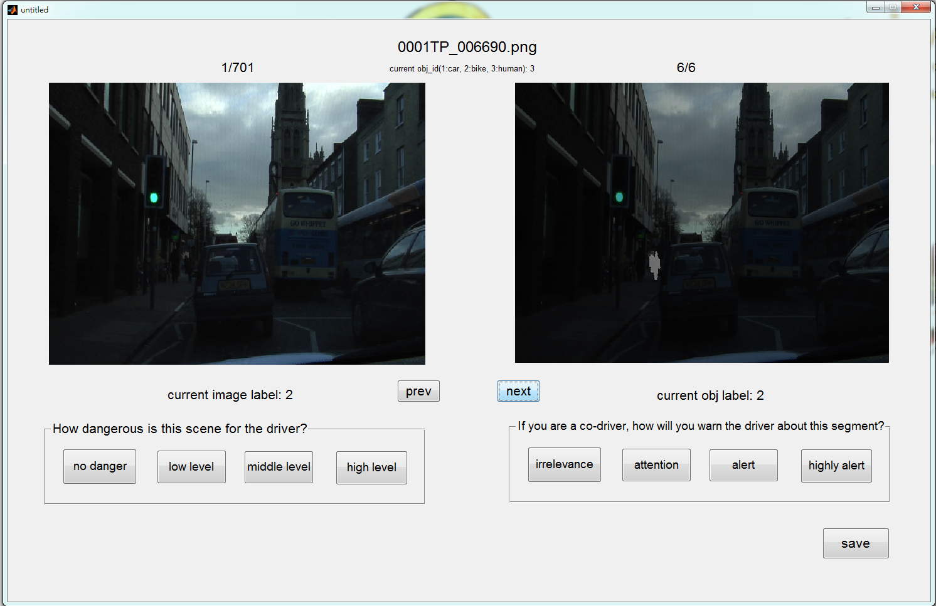
Step 4: after labeling all segments of the image. Please check whether you finish the question 1 or not. If not, you may get a warning.

Slide 11
If you want to take a break, you feel free to use the save button saving your current state in case any unlucky happened.

